Slide 1
Chapter 06
The Money Market and Bond Market
(Why money markets is important, who participate and what tools and techniques they use)

Slide 2
The Money Market
Money market securities are short-term, low-risk, and very liquid.
Because of the high degree of safety and liquidity these securities exhibit, they are close to being money, hence their name.
The money markets have been active since the early 1800s but have become much more important since 1970, when interest rates rose above historic levels.
Rise in short-term rates, coupled with a regulated ceiling on the bank rates resulted in a rapid outflow of funds from financial institutions in the late 1970s and early 1980s.
This outflow caused many banks.
The industry regained its health only after massive changes were made to bank regulations with regard to money market interest rates

Slide 3
The Money Markets
Money—currency—is not traded in the money markets
Money market securities have three basic characteristics in common:
They are usually sold in large denominations.
They have low default risk.
They mature in one year or less from their original issue date. Mostly less than 120 days
Money market securities usually have an active secondary market
Microsoft’s annual report states, “We consider all highly liquid interest-earning investments with a maturity of 3 months or less at date of purchase to be cash equivalents.”

Slide 4
The Money Markets
Money markets are wholesale markets
Transactions are very large, usually in excess of $1 million.
Instead of individual investors, dealers and brokers bring customers together
These traders will buy or sell $50 or $100 million in mere seconds—certainly not a job for the faint of heart!

Slide 5
The Need of Money Markets
The banking industry exists primarily to provide short-term loans and to accept short-term deposits
Banks mediate the asymmetric information problem between saver-lenders and borrower-spenders and earn profits meanwhile
However, the banking industry is subject to more regulations and governmental costs than are the money markets
The money markets have a distinct cost advantage over banks in providing short-term funds

Slide 6
The Need of Money Markets
The limits on interest rates were not particularly relevant until the late 1950s.
These limits became especially troublesome to banks in the late 1970s and early 1980s when inflation pushed short-term interest rates above the level that banks could legally pay.
Investors pulled their money out of banks and put it into money market security accounts
Commercial bank interest rate ceilings were removed in March of 1986, but by then the retail money markets were well established

Slide 7
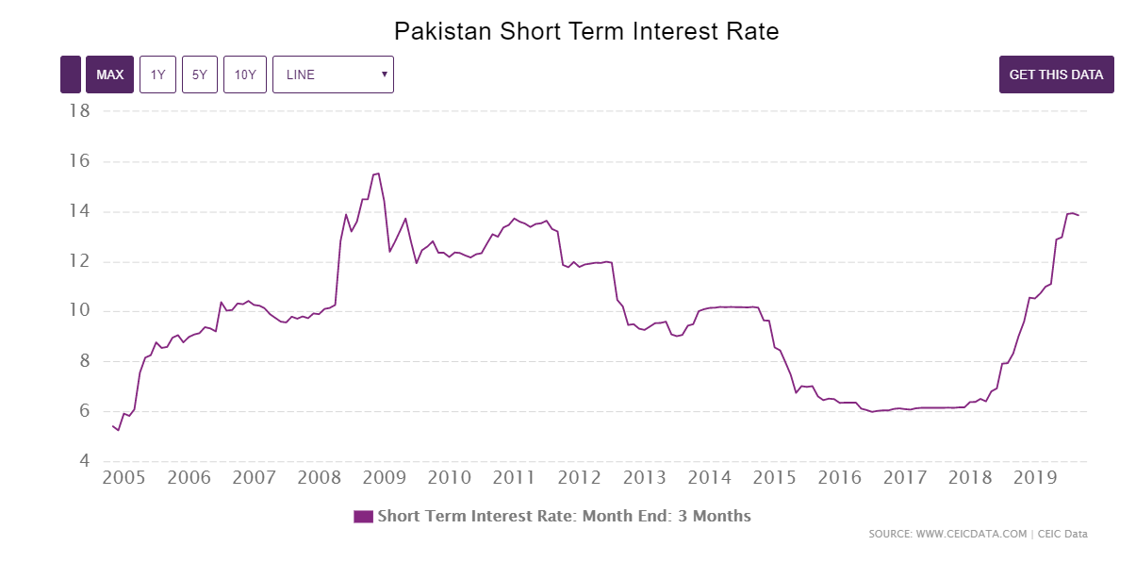

Slide 8
Purpose of the Money Markets
Money market is an ideal place for a firm or financial institution to “warehouse” surplus funds until they are needed.
It also provides a low-cost source of funds to firms, the government, and intermediaries that need a short-term infusion of funds.
Most investors use the money market as an interim investment that provides a higher return than holding cash or money in banks
Idle cash represents an opportunity cost in terms of lost interest income. The money markets provide a means to invest idle funds and to reduce this opportunity cost.

Slide 9
Purpose of the Money Markets
Investment advisers often hold some funds in the money market so that they will be able to act quickly to take advantage of investment opportunities they identify.
Most investment funds and financial intermediaries also hold money market securities to meet investment or deposit outflows.
The sellers of money market securities find that the money market provides a low cost source of temporary funds

Slide 10
Participants of the Money Markets

Slide 11
Participants of the Money Markets

Slide 12
Money Market Instruments
Treasury Bills
Federal Funds
Repurchase Agreements
Negotiable Certificates of Deposit
Commercial Paper
Banker’s Acceptances
Eurodollars

Slide 13
Treasury Bills
Used to finance the national debt
Sold with 28, 91, and 182-day maturities
Treasury bills can be purchased over the Internet (after Sep 1998)
Issued at a discount from par
$i_{discount}= \frac{F−P}{F}×\frac{360}{n}$ (where n=no of days till maturity)
$i_{investment}= \frac{F−P}{P}×\frac{365}{n}$
Investment rate % is a more accurate representation of investor earning

Slide 14
Federal Funds
Short-term funds transferred between financial institutions, usually for a period of one day
Fed funds really have nothing to do with the Federal Govt.
These funds are held at the Federal Reserve bank
Began in the 1920s
Banks must keep a certain % of their deposits with Fed Reserve
They analyze their reserve position on a daily basis and either borrow or invest in fed funds

Slide 15
Repurchase Agreements (repos)
Same as fed funds except that nonbanks can participate
A firm can sell Treasury securities to buy them back at a specified future date
Maturity is commonly from 3 to 14 days
Govt. security dealers may sell securities to a bank with the promise to buy the securities back the next day to manage their liquidity and take advantage of anticipated changes in interest rates

Slide 16
Negotiable Certificates of Deposit
A bank-issued security that states a deposit and specifies the interest rate and the maturity date
CD is a term security as opposed to a demand deposit
Negotiable CD is also called a bearer instrument and can be bought and sold until maturity
NCD denominations range from $100,000 to $10 million and a maturity of one to four months
Citibank issued the first large certificates of deposit in 1961

Slide 17
Commercial Paper
Unsecured promissory notes, issued by corporations, that mature in no more than 270 days (to avoid the need to register issue with SEC)
Only the largest and most creditworthy corporations issue them
The interest rate the corporation is charged reflects firm’s level of risk
Most commercial paper actually matures in 20 to 45 days
Like T-bills, most commercial paper is issued on a discounted basis
Nonbank corporations use commercial paper extensively to finance the loans that they extend to their customers

Slide 18
Banker’s Acceptances
An order to pay a specified amount of money to the bearer on a given date and have been in use since the 12th century
Used to finance goods that have not yet been transferred from the seller to the buyer
A bank issues a banker’s acceptance to substitute its creditworthiness for that of the purchaser
They can be bought and sold until they mature (they are bearer)

Slide 19
Eurodollars
Many contracts around the world call for payment in U.S. dollars due to the dollar’s stability, thus many companies and governments choose to hold dollars
Eurodollar deposits are time deposits
Historically, Large London banks offered to hold dollar-denominated deposits in British banks. These deposits were dubbed Eurodollars
The market grew rapidly because depositors receive a higher rate of return on a dollar deposit in the Eurodollar market than in the domestic market

Slide 21
Comparing Money Market Securities
Interest rates of all of the money market instruments appear to move very closely together over time
Reason: all have very low risk and a short term
They all have deep markets and so are priced competitively
Due to same risk and term characteristics, they are close substitutes
If one interest rate should temporarily depart from the others, market supply-and-demand forces would soon cause a correction

Slide 23
How Money Market Securities Are Valued
The process of computing a present value:
$PV= \frac{FV}{{(1+i)}^{n}}$
Suppose:
You have to submit the bid for Treasury bills this week
You decide you need a 2% return
Securities have a one-year maturity
Treasury bill will pay Rs.1,000 when it matures
To compute how much we will pay today we find the present value of Rs. 1,000

